Slide 1

Year 2 Scientific Skills Module
Career Research & Application
Career Orientation

Slide 2
Assessments
Assessment | Assessment Topic | Deadline
1 | Skills | 22/10/20 – Week 2 Thurs
2 | Careers Research & Applications | 19/11/20 - Week 9 Thurs
Collectively assessments are worth 10% of Scientific Skills (Physics)
All assessments and course information are available in a sub section to the stated modules above in Moodle called Year 2 Careers Course.
All assessments must be submitted electronically via Turnitin.
24 hour late policy where you will have a deduction of

Slide 3
Assessment 2 – Q1 & 2
Q1) Pick a role that interests you from the SEPnet (Physics) or Booklet (Maths.)
NB – If you are currently applying to a different organisation you can use that as the role you pick.
Q2) Research the chosen organisation that the role is for: explain
what they do
why you have chosen them.

Slide 4
Assessment 2 : Q3 & Q4
Q3: Looking at the examples and guidance submit a CV (no longer than 2 pages) for the role selected
Q4:Looking at the examples and guidance submit a 1 page covering letter for the role selected.

Slide 5
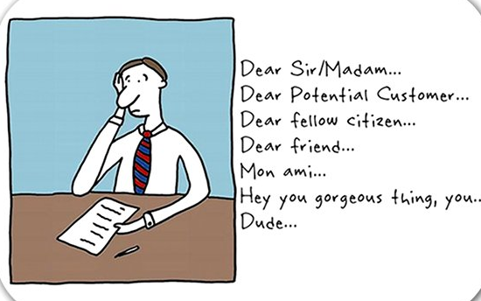
Today’s session
Differences between CVs and cover letters
Work through a cover letter to illustrate the content and structure
Tips for effective cover letters

Slide 6
Cover Letters
A cover letter is piece of text that introduces another document, usually a CV
Cover letter is sometimes read before a CV. Very, very important.
Send with a CV unless the advert specifies “no cover letter”
Include the cover letter either as the main body of your email with the CV (PDF) attached,or as a separate PDF.
Normally laid out in letter format.

Slide 7



How is a cover letter different from a CV?
Write about ….. | CV | Cover Letter
Skills & experiences | Details all relevant | Emphasises just 2 or 3
The company you are applying to
WHY you are interested in the company/ the role

Slide 8
What goes where?
Careers Service
Which job applied
for
Contact details
Employment
history
Goes in a CV?
Goes in a cover letter?
Motivation for
organisation
Information demonstrating
meet job specification
Motivation for job
role
Type into the chat
Notes:
Bring up slide and do not hit any buttons instead ask them to type their ideas into the chat – go through each heading in turn & hit enter to bring up the answer.
CV – Presents the facts
Cover Letter – Draws in the links between your skills and experiences and the specific company and role for which you’re applying. Contains: motivation for job, motivation for organisation, which job applying for, how your skills match the job spec
Exercise – what goes where?

Slide 9
Simple suggested structure
Paragraph 1. - Simple greeting & introduction – Formal greeting and state job applying for & where seen advert.
Paragraph 2. - Why THIS sector / company/job Why you are interested in the organisation Why you want the job)
Career Plans, motivation
Paragraph 3. - How my experience and education show I am suitable for this position – use your CV and the person specification.
focus on a few of your Unique Selling Points from your CV
Paragraph 4. - Simple close -Thank you for reading my application etc., formal sign off
Notes:
Click and talk through each section
Lets break each of these sections down and go through them in a little more detail.

Slide 10
Paragraph 1 - Greeting and introduction
Dear ……
I am a second year physics student at Royal Holloway
University of London. I would like to apply for the
Nuclear control systems, summer placement with
Ultra Energy as advertised on the Gradcracker website. I have also attached a copy of my CV.
Notes:
Start with a formal greeting
Preferably write to a person – if they specify
If not Dear Sir / Madam
Keep it short - no need for a long introduction – you don’t need to say who you are.
Remind them you have also attached your CV just in case the two documents get separated.

Slide 11
Paragraph 2 – Why this sector/company/job
Why the organisation?
Geography? Service Ethos? Training?
Clients? Speed of promotion? Identify with product or values?
Size? Technology? Corporate Social Responsibility?
Niche or general, Contact with organisation (LinkedIn / in person).
Why the Job Role?
Use technical skills, Solve real life problems?
Enjoy doing job day-to-day, Enjoy using the personal skills required.
Notes:
Paragraph 2 is really all about your research - why this company/ sector and why the job role - try and delve a little deeper than just looking on their website.
Some things to consider might be – what matters to you?

Slide 12
Paragraph 2 – why this sector/company/job example 1
Careers Service
Your organisation is a leader in its field. It has an international reputation and is also one of the most respected businesses in the UK. I am very interested in nucleonics as demonstrated by my degree and I would welcome all the different opportunities available to me.
I would also like to work abroad at some point and so the global nature of your organisation appeals to me. Finally, I’d like to work for the organisation because the role matches my skills. I am interested in developing new skills and believe that I could be an asset to your company.
In your break out room - rate answer out of 10 and discuss
3 ways to improve this paragraph.
Notes:
Lets look at this example

Slide 13
Paragraph 2 – why this sector/company/job example 2
Careers Service
I am familiar with the integration of software and new neutron capture techniques within your products including NeutOcapt, and the pivotal importance of your 2017 expansion that increased its use by sample analysts by 28 %.
I’m also attracted to the scientific reputation of the your business as described in a recent ‘Nuclear Energy Today’ magazine business profile, particularly the use of your proprietary software and neutron sources to speed identification of uranium in lead contaminated samples.
In September this year, I attended an talk hosted by the Institute of Physics and Ultra Energy on machine learning (ML). I was especially interested in how ML has enabled unsupervised processing of complex and enormous amounts of data. Additionally I was struck by the enthusiasm of your recent trainees as they described how their work on this project has formed a key part of their training programme. I have been interrogating databases as part of a recent physics project this term, and am keen to develop my skills further in this area.
Notes:
Why is this better?

Slide 14

Paragraph 3 – how your skills and experience show I am suitable for this position
As one of four physics ambassadors for my department, I worked closely with the team to plan and demonstrate experiments and lead tours of the department for potential students and their parents. I am extremely enthusiastic about the benefits of studying physics and regularly received positive feedback from my groups. My second year module on scientific computing skills has given me knowledge of python and SQL and I really enjoy the problem solving aspect that comes with this. This module also introduced me to databases and I recently completed a short online course on how to use databases within physics and engineering. Working in a local café over the summer helped me to further develop my communication and time management skills. Serving a wide range of clients in a busy environment and ensuring that they had a positive experience was paramount to the success of the business.
Notes:
In this section Always go back to the job description / person specification.
you’ll see that much of the information might be already on your CV. The skills that the company are looking for should be pulled out and you can go into more detail and expand further than you would on your CV. You need to avoid cutting and pasting straight from your CV.

Slide 15
Close
I enclose a copy of my CV and hope that I may be considered for the summer placement programme. I am available for interview at any time and look forward to hearing from you.
Yours sincerely (Dear Sir/Madam)
or
Yours faithfully (a named person)
Notes:
No need to spend a long time on this just end it professionally
Click – depending on how you address the letter there are different endings

Slide 16
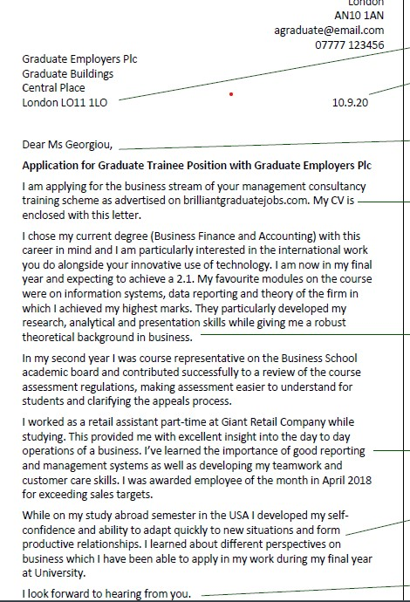
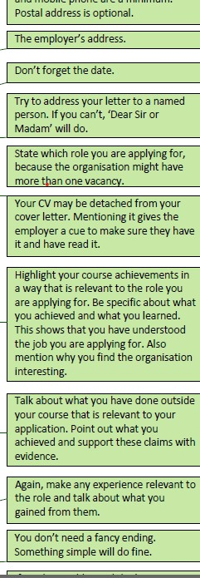
Copy of this cover letter is available on the employability Moodle

Slide 17

Top Tips
Each cover letter should be different
It is OK to have some repetition between CV & cover letter
½ - 1 page of a Word document
Use active language
Liaised, collaborated, communicated, analysed
Careful proof reading for spelling & grammar:
training otters
Physics and Moths
Payed close attention to detail
Always make sure any attachments are PdF’s
Notes:
Each cover letter needs to be carefully tailored – if you write it and then you can just substitute the name of any company – its not tailored enough
Generally there will be some repetition – but don’t just cut and paste from your CV. Also don’t include experience or work in your cover letter that aren’t on your CV.
You should have the list of verbs already
Be careful – these three examples are genuine examples – and because they are real words they don’t show up when you use the spell checker.

Slide 18
Assessment 2 – Q1 & 2
Q1) Pick a role that interests you from the SEPnet (Physics) or Booklet (Maths.)
NB – If you are currently applying to a different organisation you can use that as the role you pick.
Q2) Research the chosen organisation that the role is for: explain
what they do
why you have chosen them.

Slide 19
Assessment 2 : Q3 & Q4
Q3: Looking at the examples and guidance submit a CV (no longer than 2 pages) for the role selected
Q4:Looking at the examples and guidance submit a 1 page covering letter for the role selected.
Today we are going to be looking at how to write an effective cover letter

Slide 20
Any Questions?

